Slide 1

Momentum Trading on Cryptocurrencies
MF796 project
Group 8 members： Chengyang Miao; Yu Wang; Haozhi Chen; Zhixi Su; Xizhi Wang; Xingyi Yin

Slide 2
Introduction
The project entails trading cryptocurrencies using momentum strategies.
The following are the steps followed:
Collecting price data sets from reputable websites
Constructing portfolio based on different cryptocurrencies caps in the market.
Implementing technical indicators and develop momentum strategies.
Conclusion is based on evaluation of the process.

Slide 3
Why Choose Cryptocurrencies
Cryptocurrency is a form of virtual money that enables trade through the internet.
Crypto is very popular among different investors.
Dramatic increase in value of cryptocurrencies attract investors.
More people are looking for future opportunities in crypto.

Slide 4
Why Choose Momentum Trading
Momentum trading has been a successful and popular investing strategy.
Core ideas of momentum trading help people earn in financial markets.
It would align with our goal of making high returns.
Momentum trading’s core idea is taking advantage of asset tendency and earn future returns.
It’ll help in selecting or making reliable indicators.

Slide 5
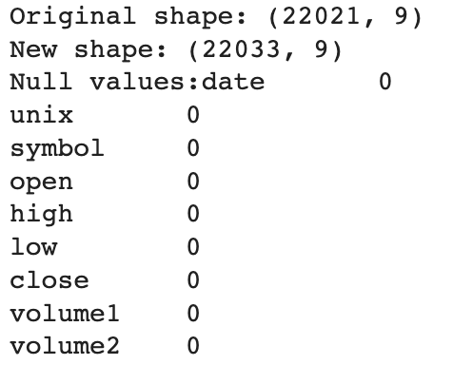
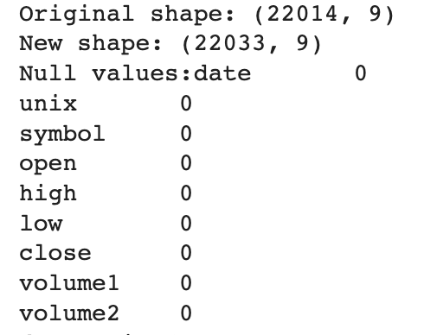
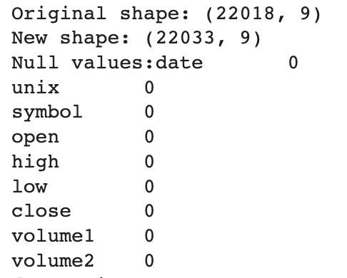
Data selection
We picked 20 relative large cryptos from early 2019 snapshot
We used hourly data and set the timeframe between Faburary 2019 to March 2022
We preprocessed the data as there are some unmatch and missing
We have also picked some minute data to find the balance of trading period

Slide 6
Existence of Momentum
Intuition: cryptos have frequent and drastic rises and falls over time.
Indicator = x recent days MA/EMA - y previous days MA/EMA
Used to check “V-shape” patterns
The shorter the windows (x and y), the more sensitive it detects the patterns at the cost of more frequent trades.

Slide 7
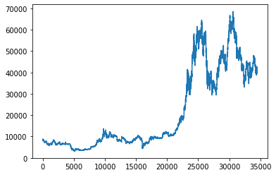
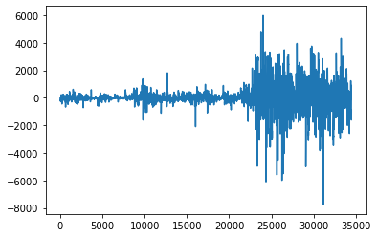
Intuition of Momentum

Slide 8
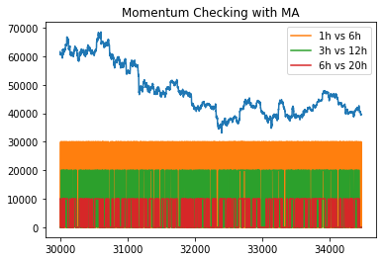
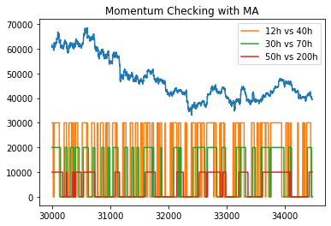
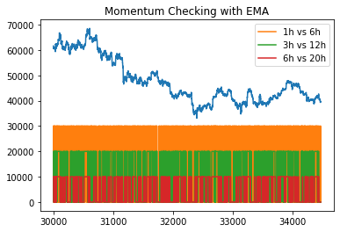
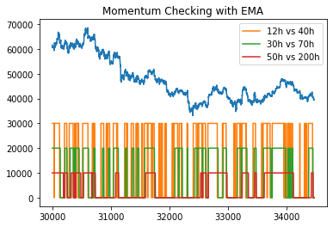

Slide 9
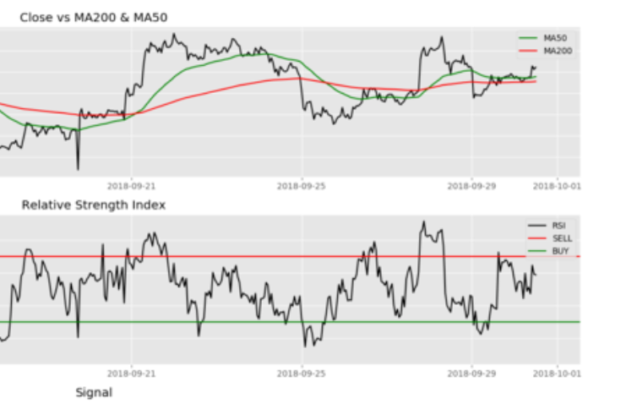
Trading Strategy
Exponetinal Moving Average
Short term vs Long term
Relative Strength Index
RS =EMA(U,n)/ EMA(D,n)
RSI =100- 100/(1+RS)
Trading Rules
1.Buy at RSI <30 short term > long term
2. Sell at RSI >70 short term < long term
3. else don’t trade

Slide 10
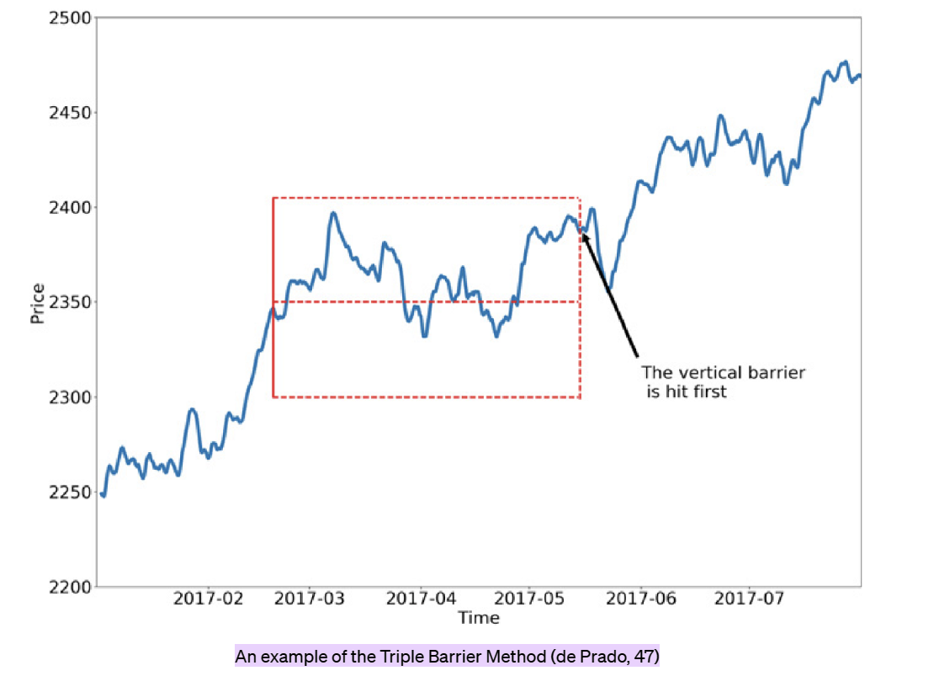
Risk Management: The Triple Barrier Method
Three Rules:
The upper barrier is hit first. Label = “buy” or “1”.
The lower barrier is hit first. Label = “sell” or “-1”.
The vertical barrier is hit first. max holding period reach

Slide 11
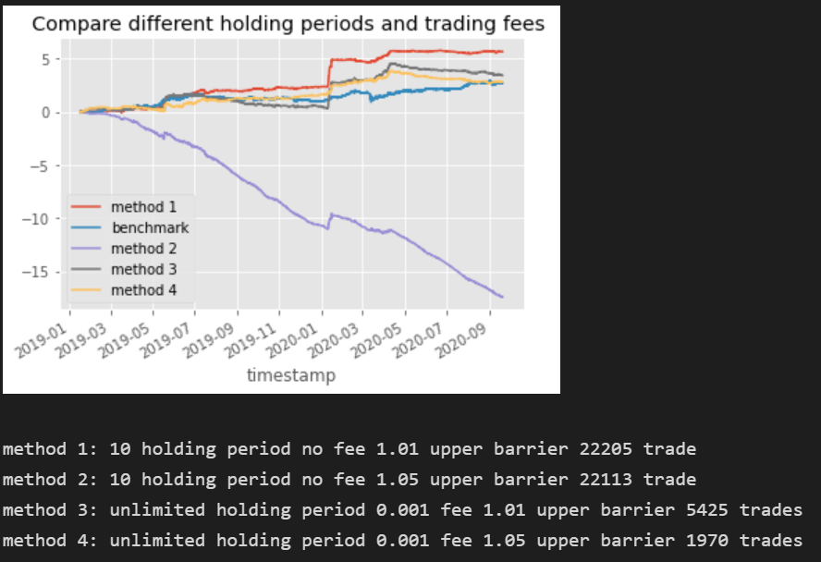
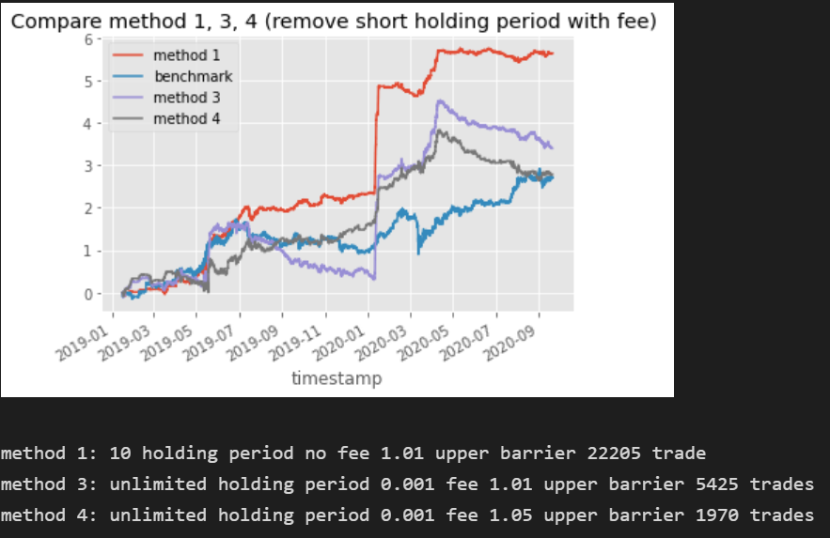
Test on ETH Using Minutely Data
Notes:
44

Slide 12
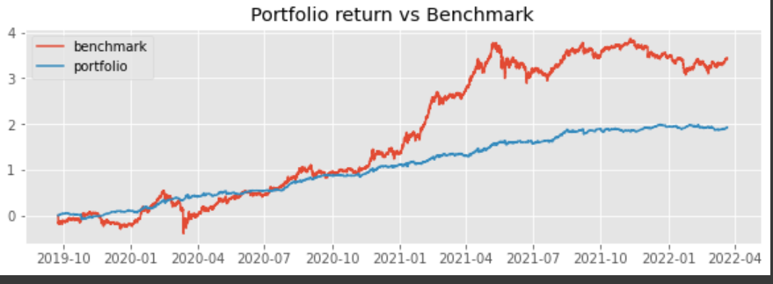

Portfolio Return vs Benchmark Using Hourly Data

Slide 13
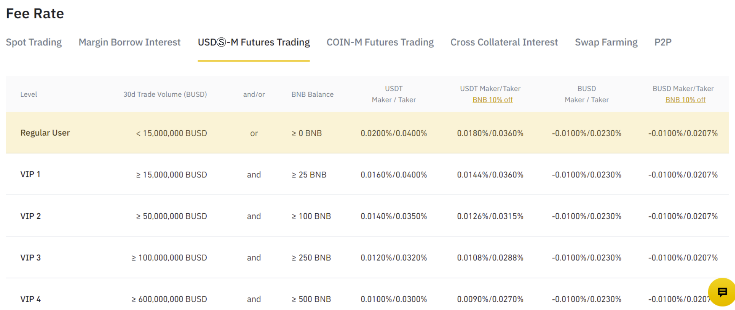
Trading Cost
We checked binance exchange and found their trading fee as following

Slide 14
Improvement
We could adjust our portfolio.
We could put our strategy into the real trade to see how the return goes. (We have achieved using binance api to receive real time data stream and also sending our order using api.)
Instead of using rsi and moving average, we could use machine learning to calculate the support and resistant price. We could send post only order to avoid the trading cost easily.

Slide 15
Conclusion
Summaries from what have we done
Our expectation in the future

Slide 16
Reference
1.https://medium.com/swlh/how-to-build-quant-algorithmic-trading-model-in-python-12abab49abe3
2.https://ai.plainenglish.io/start-using-better-labels-for-financial-machine-learning-6eeac691e660
3.https://www.ostirion.net/post/dataframe-ready-implementation-for-triple-barrier-labels

